Slide 1
Advanced Artificial Intelligence
Week #9
Dr. Qurat Ul Ain
Assistant Professor Dept. of AI & DS
FAST NUCES, Islamabad
Email: quratul.ain@isb.nu.edu.pk

Slide 2
Unsupervised Learning
Supervised learning algorithms have a clear goal: produce desired outputs for given inputs.
You are given {(x ^{(i )}, t^{(i )})} during training (inputs and targets)
Goal of unsupervised learning algorithms (no explicit feedback whether outputs of system are correct) less clear.
You are given the inputs {x ^{(i )}} during training, labels are unknown.
Tasks to consider:
Reduce dimensionality
Find clusters
Model data density
Find hidden causes
Key utility
Compress data
Detect outliers
Facilitate other learning
4 / 20

Slide 3

Unsupervised Learning
The learning algorithm would receive unlabeled raw data to train a model and to find patterns in the data
Training Data
All unlabeled data
Structured data, Labeled data, Clustering
Model

Slide 4
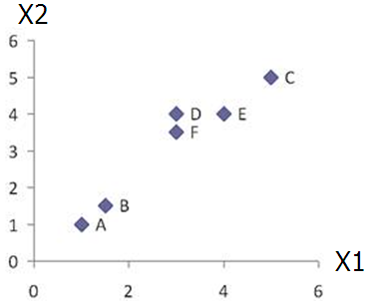
Agglomerative Clustering - Example
 | X1 | X2
A | 1 | 1
B | 1.5 | 1.5
C | 5 | 5
D | 3 | 4
E | 4 | 4
F | 3 | 3.5
Data matrix
Dist | A | B | C | D | E | F
A | 0.00 | 0.71 | 5.66 | 3.61 | 4.24 | 3.20
B | 0.71 | 0.00 | 4.95 | 2.92 | 3.54 | 2.50
C | 5.66 | 4.95 | 0.00 | 2.24 | 1.41 | 2.50
D | 3.61 | 2.92 | 2.24 | 0.00 | 1.00 | 0.50
E | 4.24 | 3.54 | 1.41 | 1.00 | 0.00 | 1.12
F | 3.20 | 2.50 | 2.50 | 0.50 | 1.12 | 0.00
d_{AB} = ((1-1.5)²+(1-1.5)^{2)1/2} = 0.707
Euclidean distance

Slide 5
Agglomerative Clustering - Example
Merge two closest clusters
 | X1 | X2
A | 1 | 1
B | 1.5 | 1.5
C | 5 | 5
D | 3 | 4
E | 4 | 4
F | 3 | 3.5
Merge them into single cluster`
Data matrix
Dist | A | B | C | D | E | F
A | 0.00 | 0.71 | 5.66 | 3.61 | 4.24 | 3.20
B | 0.71 | 0.00 | 4.95 | 2.92 | 3.54 | 2.50
C | 5.66 | 4.95 | 0.00 | 2.24 | 1.41 | 2.50
D | 3.61 | 2.92 | 2.24 | 0.00 | 1.00 | 0.50
E | 4.24 | 3.54 | 1.41 | 1.00 | 0.00 | 1.12
F | 3.20 | 2.50 | 2.50 | 0.50 | 1.12 | 0.00
Find two closest clusters

Slide 6
Agglomerative Clustering - Example
Dist | A | B | C | D | E | F
A | 0.00 | 0.71 | 5.66 | 3.61 | 4.24 | 3.20
B | 0.71 | 0.00 | 4.95 | 2.92 | 3.54 | 2.50
C | 5.66 | 4.95 | 0.00 | 2.24 | 1.41 | 2.50
D | 3.61 | 2.92 | 2.24 | 0.00 | 1.00 | 0.50
E | 4.24 | 3.54 | 1.41 | 1.00 | 0.00 | 1.12
F | 3.20 | 2.50 | 2.50 | 0.50 | 1.12 | 0.00
Dist | A | B | C | D,F | E
A | 0.00 | 0.71 | 5.66 | ? | 4.24
B | 0.71 | 0.00 | 4.95 | ? | 3.54
C | 5.66 | 4.95 | 0.00 | ? | 1.41
D,F | ? | ? | ? | 0.00 | ?
E | 4.24 | 3.54 | 1.41 | ? | 0.00
Update Distance Matrix

Slide 7
Agglomerative Clustering - Example
Min Distance – Single Linkage
Dist | A | B | C | D | E | F
A | 0.00 | 0.71 | 5.66 | 3.61 | 4.24 | 3.20
B | 0.71 | 0.00 | 4.95 | 2.92 | 3.54 | 2.50
C | 5.66 | 4.95 | 0.00 | 2.24 | 1.41 | 2.50
D | 3.61 | 2.92 | 2.24 | 0.00 | 1.00 | 0.50
E | 4.24 | 3.54 | 1.41 | 1.00 | 0.00 | 1.12
F | 3.20 | 2.50 | 2.50 | 0.50 | 1.12 | 0.00
D_{(D,F)→A} = min(d_{DA},d_{FA})=min(3.61,3.20) = 3.20
D_{(D,F)→B} = min(d_{DB},d_{FB})=min(2.92,2.50) = 2.50
D_{(D,F)→C} = min(d_{DC},d_{FC})=min(2.24,2.50) = 2.24
D_{(D,F)→E} = min(d_{DE},d_{FE})=min(1.00,1.12) = 1.00
Dist | A | B | C | D,F | E
A | 0.00 | 0.71 | 5.66 | ? | 4.24
B | 0.71 | 0.00 | 4.95 | ? | 3.54
C | 5.66 | 4.95 | 0.00 | ? | 1.41
D,F | ? | ? | ? | 0.00 | ?
E | 4.24 | 3.54 | 1.41 | ? | 0.00
Dist | A | B | C | D,F | E
A | 0.00 | 0.71 | 5.66 | 3.20 | 4.24
B | 0.71 | 0.00 | 4.95 | 2.50 | 3.54
C | 5.66 | 4.95 | 0.00 | 2.24 | 1.41
D,F | 3.20 | 2.50 | 2.24 | 0.00 | 1.00
E | 4.24 | 3.54 | 1.41 | 1.00 | 0.00
Update Distance Matrix

Slide 8
Agglomerative Clustering - Example
Dist | A | B | C | D,F | E
A | 0.00 | 0.71 | 5.66 | 3.20 | 4.24
B | 0.71 | 0.00 | 4.95 | 2.50 | 3.54
C | 5.66 | 4.95 | 0.00 | 2.24 | 1.41
D,F | 3.20 | 2.50 | 2.24 | 0.00 | 1.00
E | 4.24 | 3.54 | 1.41 | 1.00 | 0.00
Dist | A,B | C | D,F | E
A,B | 0.00 | ? | ? | ?
C | ? | 0.00 | 2.24 | 1.41
D,F | ? | 2.24 | 0.00 | 1.00
E | ? | 1.41 | 1.00 | 0.00
Merge two closest clusters

Slide 9
Agglomerative Clustering- Example
Dist | A | B | C | D,F | E
A | 0.00 | 0.71 | 5.66 | 3.20 | 4.24
B | 0.71 | 0.00 | 4.95 | 2.50 | 3.54
C | 5.66 | 4.95 | 0.00 | 2.24 | 1.41
D,F | 3.20 | 2.50 | 2.24 | 0.00 | 1.00
E | 4.24 | 3.54 | 1.41 | 1.00 | 0.00
D_{(A,B)→C} = min(d_{CA},d_{CB})=min(5.66,4.95) = 4.95
D_{(A,B)→(D,F)} = min(d_{DA},d_{DB}, d_{FA},d_{FB})
=min(3.61, 2.92, 3.20, 2.50) = 2.50
D_{(A,B)→E} = min(d_{AE},d_{BE})=min(4.24,3.54) = 3.54
Dist | A,B | C | D,F | E
A,B | 0.00 | ? | ? | ?
C | ? | 0.00 | 2.24 | 1.41
D,F | ? | 2.24 | 0.00 | 1.00
E | ? | 1.41 | 1.00 | 0.00
Dist | A,B | C | D,F | E
A,B | 0.00 | 4.95 | 2.50 | 3.54
C | 4.95 | 0.00 | 2.24 | 1.41
D,F | 2.50 | 2.24 | 0.00 | 1.00
E | 3.54 | 1.41 | 1.00 | 0.00
Update Distance Matrix

Slide 10
Agglomerative Clustering - Example
Dist | A,B | C | D,F | E
A,B | 0.00 | 4.95 | 2.50 | 3.54
C | 4.95 | 0.00 | 2.24 | 1.41
D,F | 2.50 | 2.24 | 0.00 | 1.00
E | 3.54 | 1.41 | 1.00 | 0.00
Dist | (A,B) | C | (D,F),E
(A,B) | 0.00 | 4.95 | 2.50
C | 4.95 | 0.00 | 1.41
(D,F),E | 2.50 | 1.41 | 0.00
Merge two closest clusters/Update Distance Matrix

Slide 11
Agglomerative Clustering - Example
Dist | (A,B) | C | (D,F),E
(A,B) | 0.00 | 4.95 | 2.50
C | 4.95 | 0.00 | 1.41
(D,F),E | 2.50 | 1.41 | 0.00
Dist | (A,B) | ((D,F),E),C
(A,B) | 0.00 | 2.50
((D,F),E),C | 2.50 | 0.00
Merge two closest clusters/Update Distance Matrix

Slide 12
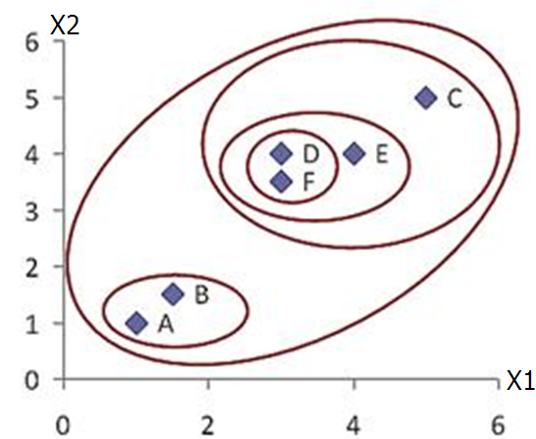
Agglomerative Clustering - Example
 | X1 | X2
A | 1 | 1
B | 1.5 | 1.5
C | 5 | 5
D | 3 | 4
E | 4 | 4
F | 3 | 3.5
Data matrix
Final Result

Slide 13
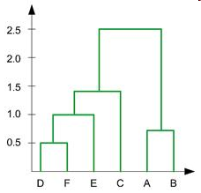
Agglomerative Clustering - Example
In the beginning we have 6 clusters: A, B, C, D, E and F
We merge cluster D and F into cluster (D, F) at distance 0.50
We merge cluster A and cluster B into (A, B) at distance 0.71
We merge cluster E and (D, F) into ((D, F), E) at distance 1.00
We merge cluster ((D, F), E) and C into (((D, F), E), C) at distance 1.41
We merge cluster (((D, F), E), C) and (A, B) into ((((D, F), E), C), (A, B)) at distance 2.50
The last cluster contain all the objects, thus conclude the computation
6
5
4
3
2
Dendrogram Representation

Slide 14
Single Link Clustering
5
1
3
5
2
1
2
3
6
4
4
Dendrogram
Nested Clusters
Notes:
Single Link (Minimum Distance)
Definition: Distance between two clusters = minimum distance between any pair of points (one from each cluster).
Effect: Tends to form long, chain-like clusters since even one close pair of points can cause merging.
In the image:
Clusters {5,2}, {3,6}, and {4} merge progressively.
Points 1 and 5 are merged last, showing it connects distant clusters through minimal links.

Slide 15
Complete Link Clustering
4
1
2
5
5
2
3
6
3
1
4
Dendrogram
Nested Clusters
Notes:
Complete Link (Maximum Distance)
Definition: Distance between two clusters = maximum distance between any pair of points (one from each cluster).
Effect: Produces compact and spherical clusters since all points in a cluster must be close.
In the image:
Clusters merge only when all inter-point distances are small.
Merging occurs at higher thresholds (4, 5), producing tighter grouping before combining.

Slide 16
Average Link clustering
5
4
1
2
5
2
3
6
1
4
3
Dendrogram
Nested Clusters
Notes:
Average Link (Mean Distance)
Definition: Distance between two clusters = average of all pairwise distances between points in both clusters.
Effect: A balance between single and complete link; less sensitive to outliers.
In the image:
Cluster merging occurs moderately — neither too early (like single link) nor too late (like complete link).
Shows smoother transitions among cluster levels.

Slide 17
Comparaison
5
4
1
1
3
2
5
5
5
2
2
1
2
3
3
6
6
3
1
4
4
4
Single Link
5
Complete Link
1
2
5
2
3
6
3
1
4
4
Average Link

Slide 18
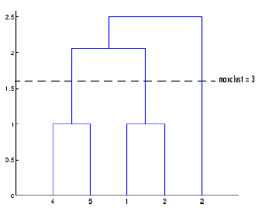
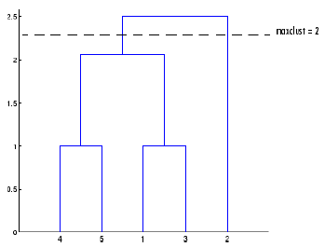
Agglomerative Clustering
Where to cut the tree?
3-cluster model
2-cluster model

Slide 19
Density-based Clustering
Basic idea:
Clusters are dense regions in the data space, separated by regions of lower object density
A cluster is defined as a maximal set of density connected points
Discovers clusters of arbitrary shape
DBSCAN is a clustering method that is used in machine learning to separate clusters of high density from clusters of low density.

Slide 20
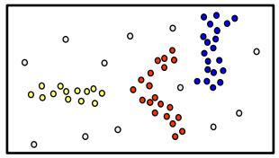
Density-based Clustering
Basic idea:
Clusters are dense regions in the data space, separated by regions of lower object density
A cluster is defined as a maximal set of density connected points
Discovers clusters of arbitrary shape
Method
– DBSCAN

Slide 21
DBSCAN
DBSCAN represents Density-Based Spatial Clustering of Applications with Noise
The algorithm improves regions with adequately high density into clusters and discovers clusters of arbitrary structure in spatial databases with noise.
It defines a cluster as a maximum set of density-connected points.
A density-based cluster is a set of density-connected objects that is maximal regarding density-reachability.
Each object not contained in some cluster is considered to be noise.
DBSCAN checks for clusters by checking the ε-neighborhood of every point in the database. If the ε-neighborhood of a point p contains more than MinPts, a new cluster with p as a core element is produced.
Notes:
DBSCAN is a density-based clustering algorithm that works on the assumption that clusters are dense regions in space separated by regions of lower density. It groups 'densely grouped' data points into a single cluster.

Slide 22

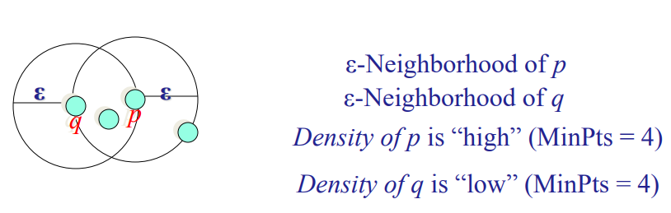
DBSCAN
DBSCAN iteratively assemble precisely density-reachable objects from these essential element, which can include the merge of a few density-reachable clusters. The process eliminates when no new point can be added to any cluster.
ε-Neighborhood – Objects within a radius of  from an object.
“High density” - ε-Neighborhood of an object contains at least MinPts of objects.
Notes:
K-means clustering is the partitioning algorithm. K-means recreates each data in the dataset to only one of the new clusters formed. A data or data point is assigned to the adjacent cluster using a measure of distance or similarity.
In k-means, an object is generated to the nearest center. It can define cannot-link constraints, and it modifies the center assignment process in k-means to the closest applicable center assignment.

Slide 23
Why DBSCAN?
Partitioning methods (K-means, PAM clustering) and hierarchical clustering work for finding spherical-shaped clusters or convex clusters.
In other words, they are suitable only for compact and well-separated clusters. Moreover, they are also severely affected by the presence of noise and outliers in the data.
Real life data may contain irregularities, like:
Clusters can be of arbitrary shape such as those shown in the figure below.
Data may contain noise.

Slide 24
DBSCAN Algorithm
DBSCAN algorithm requires two parameters:
Eps : It defines the neighborhood around a data point i.e. if the distance between two points is lower or equal to ‘eps’ then they are considered as neighbors. If the eps value is chosen too small then large part of the data will be considered as outliers. If it is chosen very large then the clusters will merge and majority of the data points will be in the same clusters. One way to find the eps value is based on the k-distance graph.
MinPts: Minimum number of neighbors (data points) within eps radius. Larger the dataset, the larger value of MinPts must be chosen. As a general rule, the minimum MinPts can be derived from the number of dimensions D in the dataset as, MinPts >= D+1. The minimum value of MinPts must be chosen at least 3.
Notes:
Epsilon is simply radius.

Slide 25
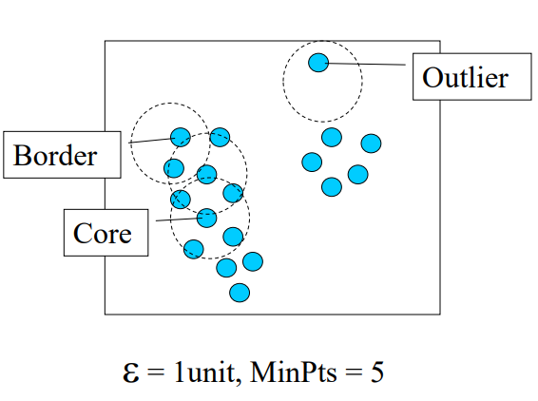
Core, Border & Outlier
Given ε and MinPts, categorize the objects into three exclusive groups.
A point is a core point if it has more than a specified number of points (MinPts) within Eps—These are points that are at the interior of a cluster.
A border point has fewer than MinPts within Eps, but is in the neighborhood of a core point.
A noise point is any point that is not a core point nor a border point.

Slide 26
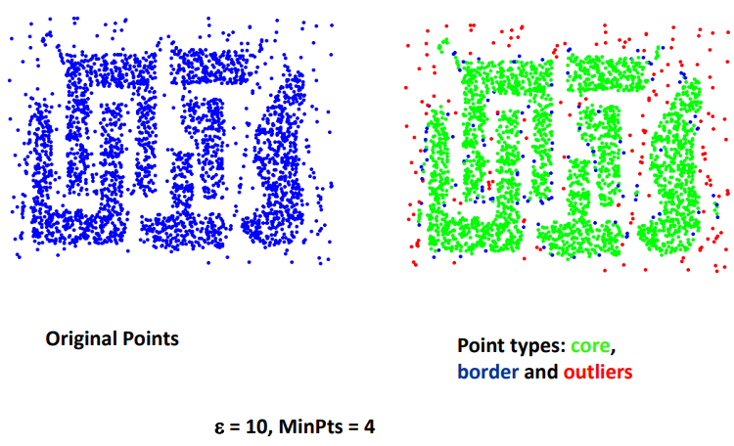
Example

Slide 27
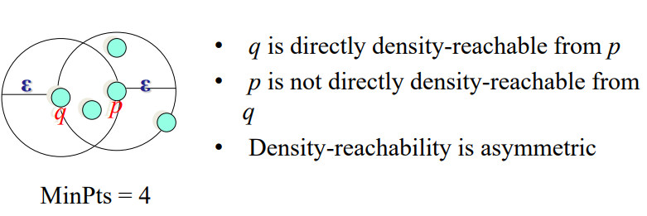
Density-reachability
Directly density-reachable
An object q is directly density-reachable from object p if p is a core object and q is in p’s ε -neighborhood

Slide 28
Density-reachability
Density-Reachable (directly and indirectly):
A point p is directly density-reachable from p2
p2 is directly density-reachable from p1
p1 is directly density-reachable from q
p ← p2 ← p1 ← q form a chain

Slide 29
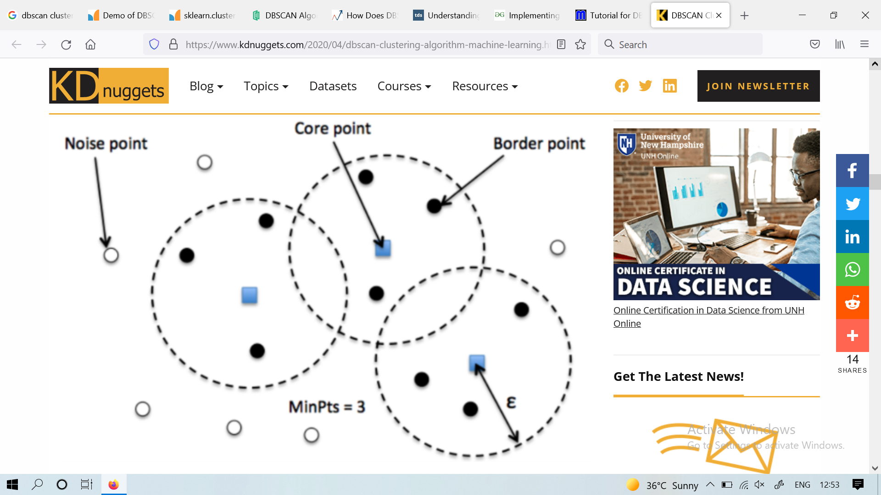
DBSCAN Algorithm
Core — This is a point that has at least m points within distance n from itself.
Border — This is a point that has at least one Core point at a distance n.
Noise — This is a point that is neither a Core nor a Border. And it has less than m points within distance n from itself.

Slide 30
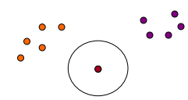
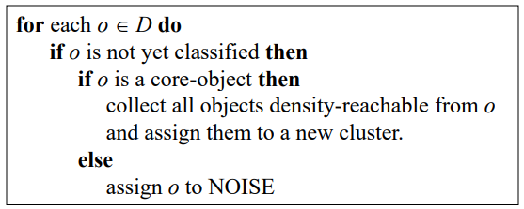
DBSCAN Algorithm: Example
Parameter
• ε = 2 cm
• MinPts = 3

Slide 31
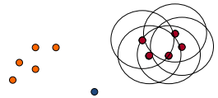
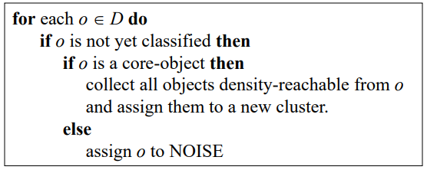
DBSCAN Algorithm: Example
Parameter
• ε = 2 cm
• MinPts = 3

Slide 32
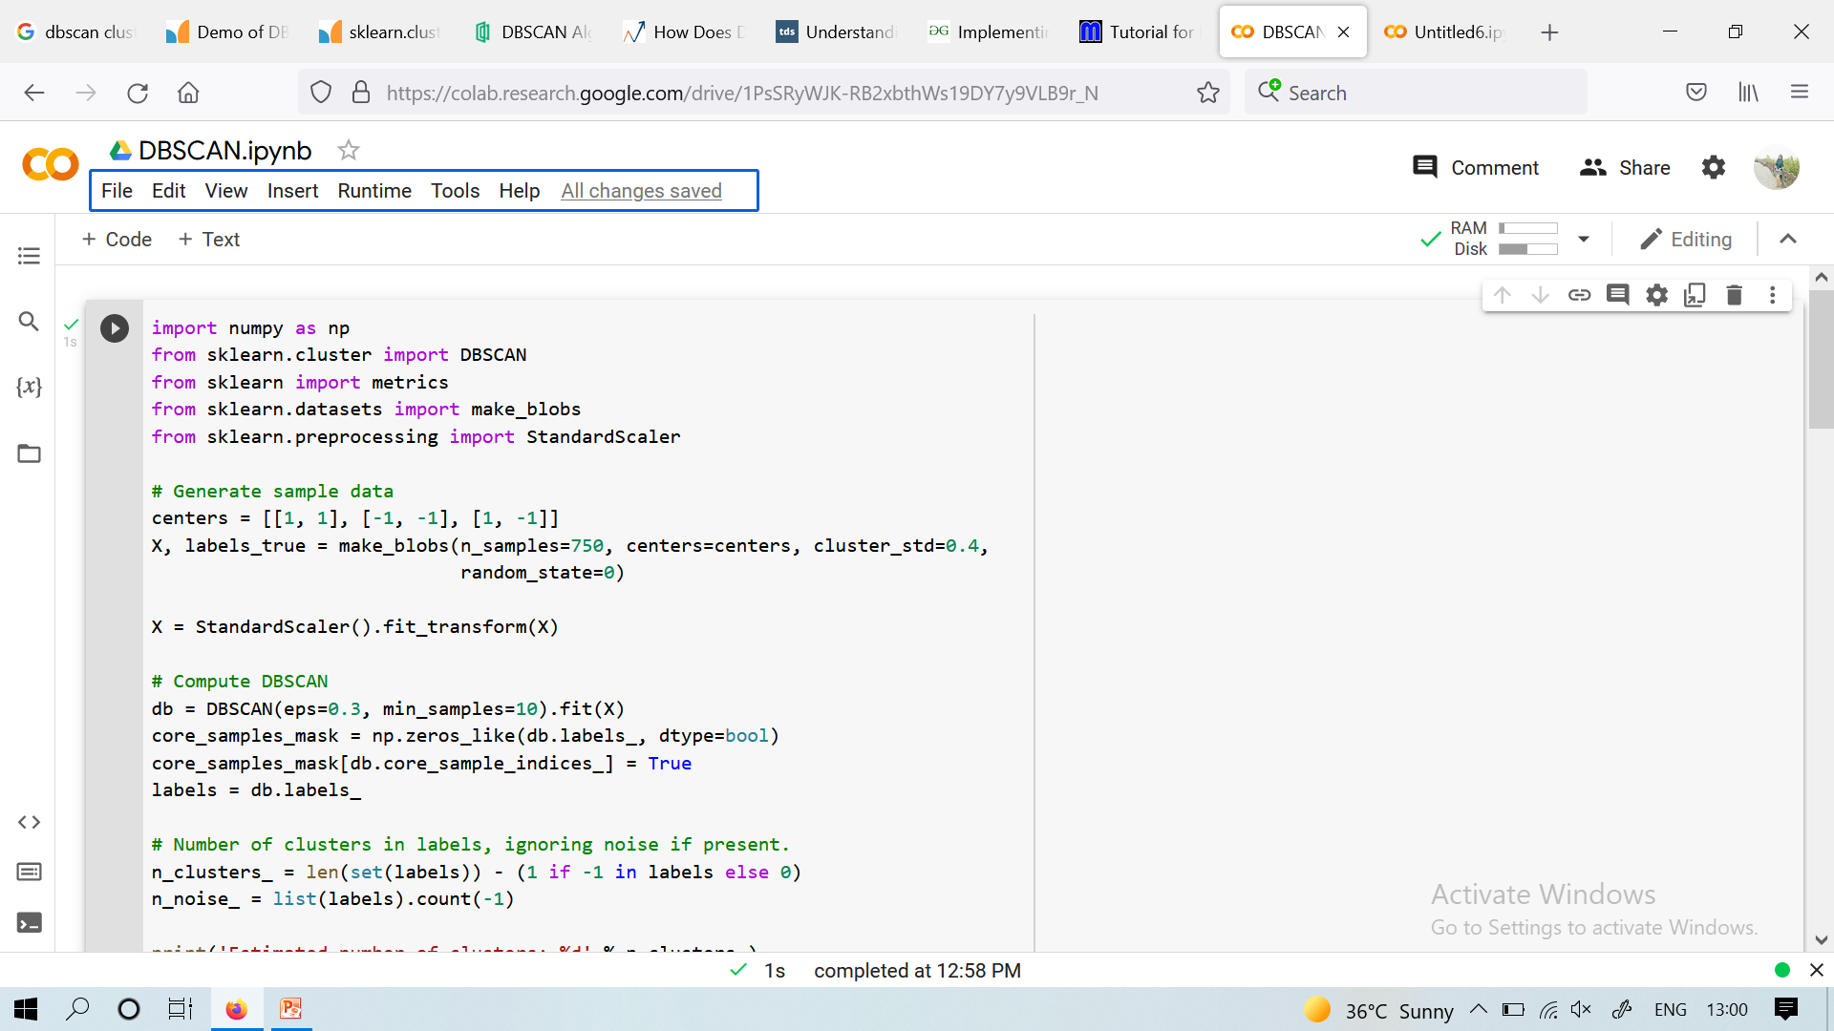
DBSCAN

Slide 33
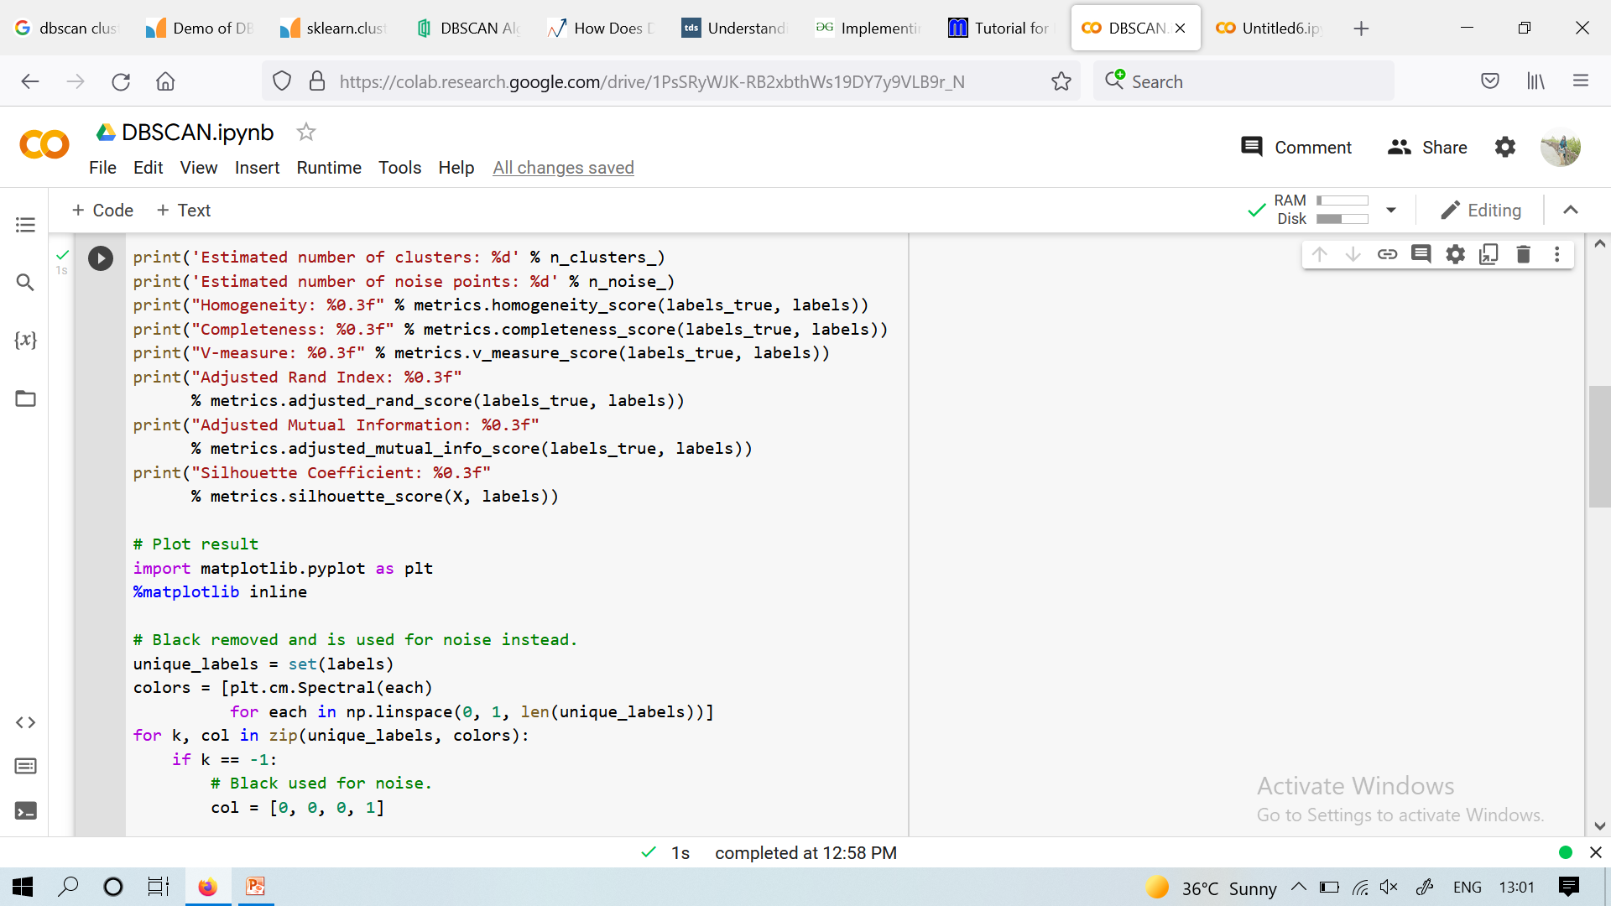
DBSCAN

Slide 34
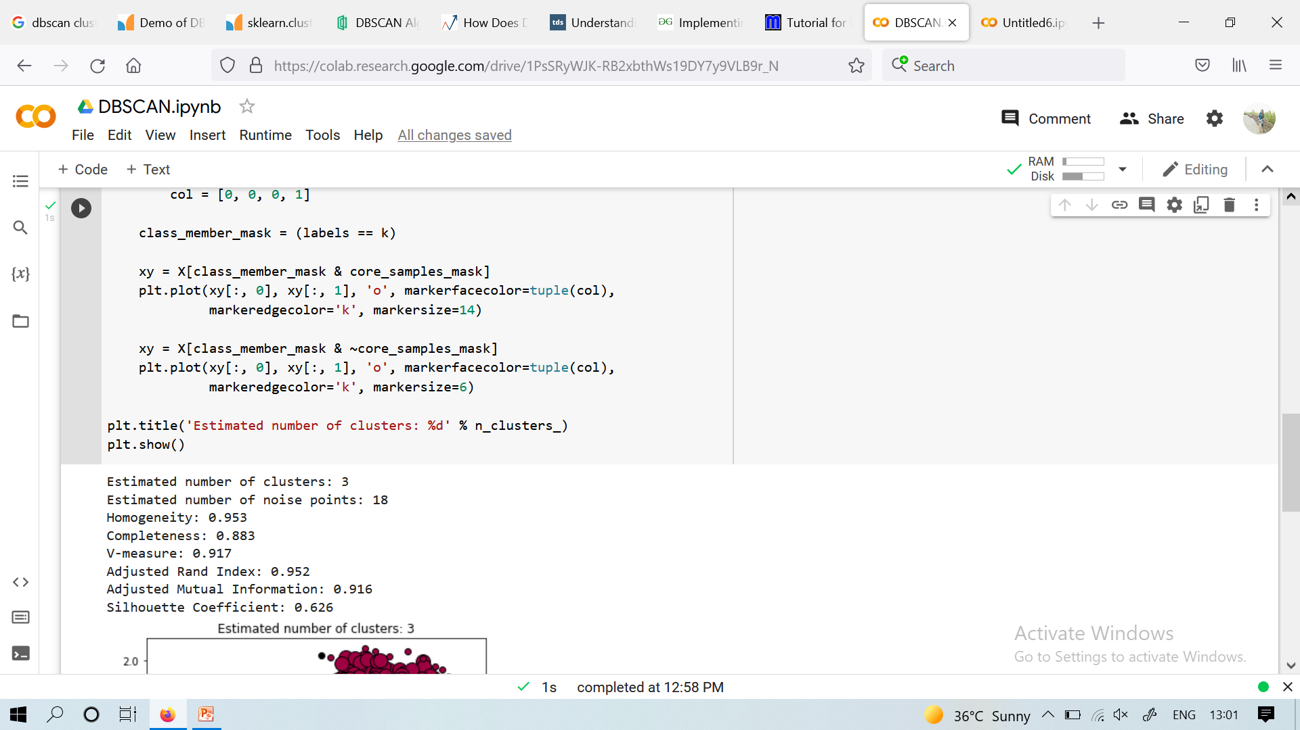
DBSCAN

Slide 35
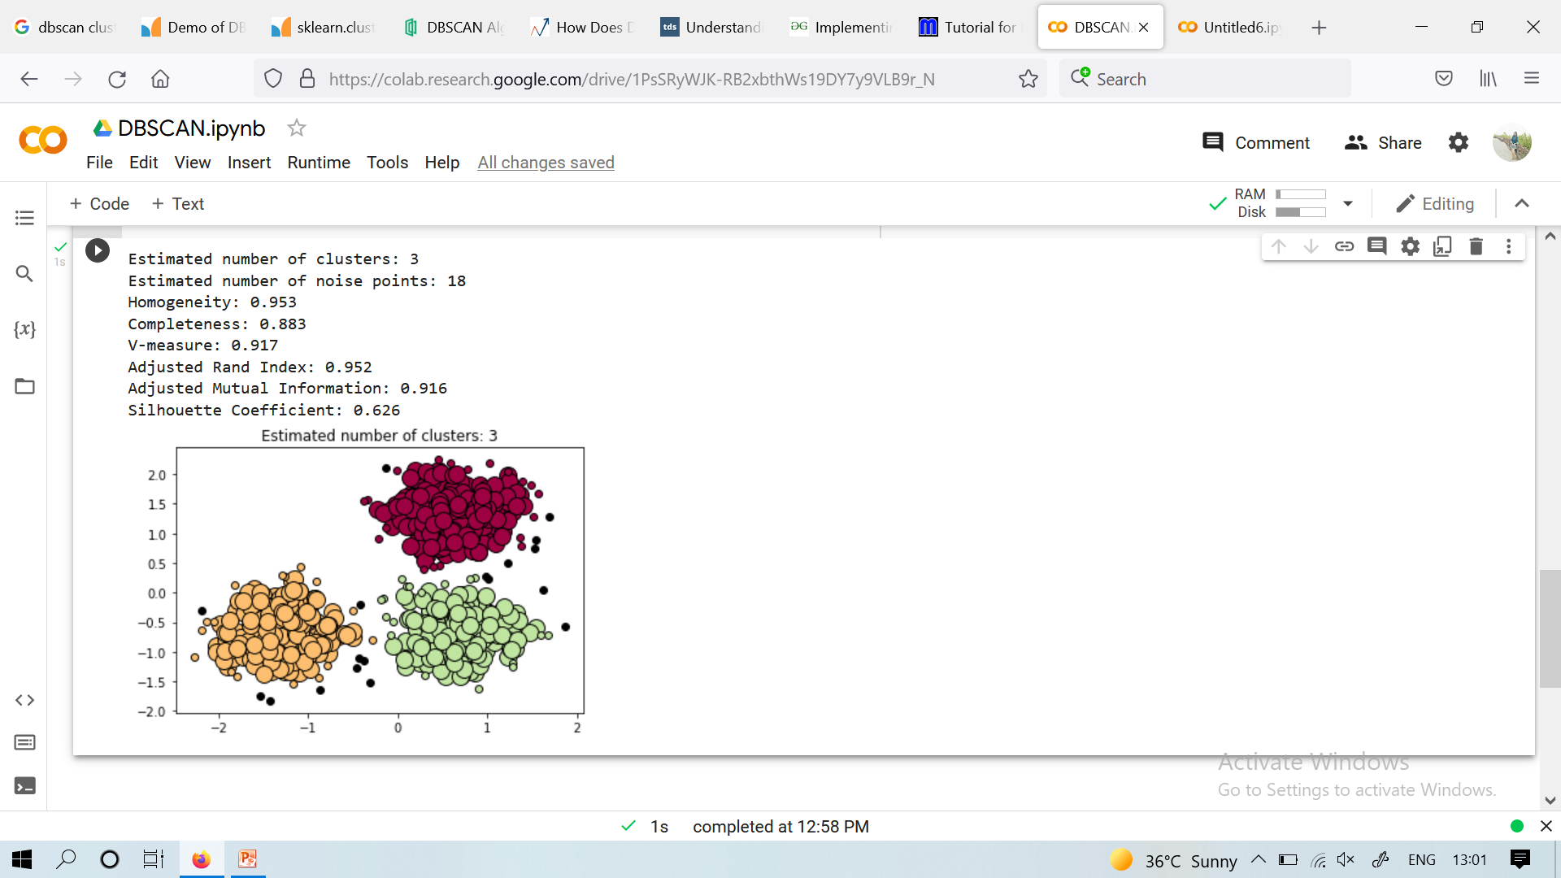
DBSCAN

Slide 36
References
Introduction to Data Mining, P.N. Tan, M. Steinbach, V. Kumar, Addison Wesley
An efficient k-means clustering algorithm: Analysis and implementation, T. Kanungo, D. M.
Mount, N. Netanyahu, C. Piatko, R. Silverman, and A. Y. Wu, IEEE Trans. PatternAnalysis and Machine Intelligence, 24 (2002), 881-892
http://www.cs.cmu.edu/~cga/ai-course/kmeans.pdf
http://www.cse.msstate.edu/~url/teaching/CSE6633Fall08/lec16%20k-means.pdf

